Slide 1
Lawren Harris

Slide 2
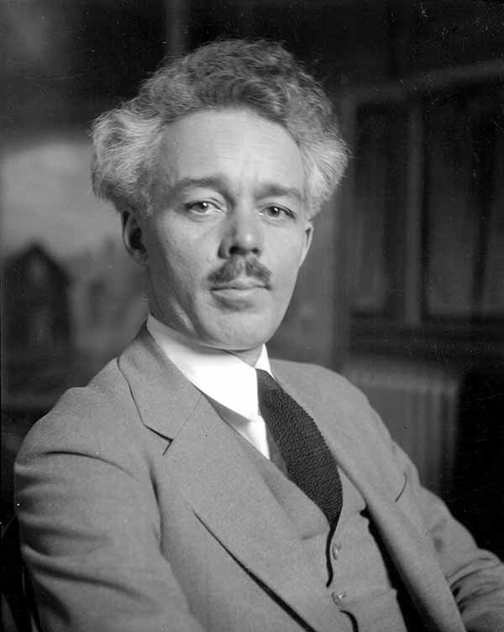
Lawren Harris
Canadian painter
Born in Brantford, 1885
Founded the Group of Seven

Slide 3
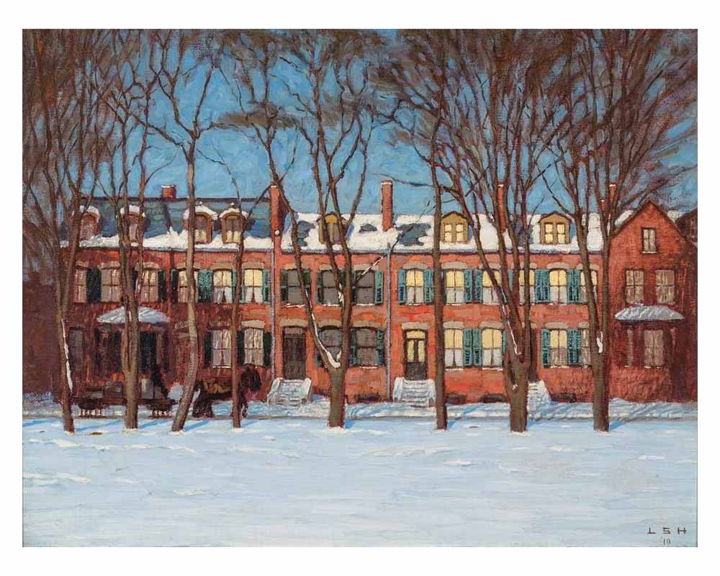
Notes:
Prompt the class to describe what they see.
Can they guess where this is or what year it was made?
What do they like or dislike about this painting?
Do the same for the next two slides as well.
Houses on Wellington Street, 1910

Slide 4
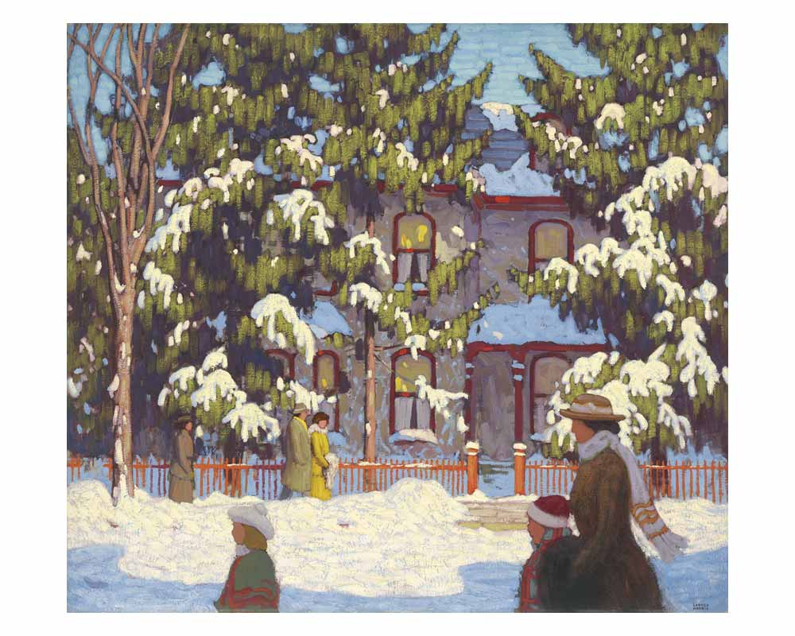
Notes:
Winter Afternoon, City Street, Toronto, 1918

Slide 5
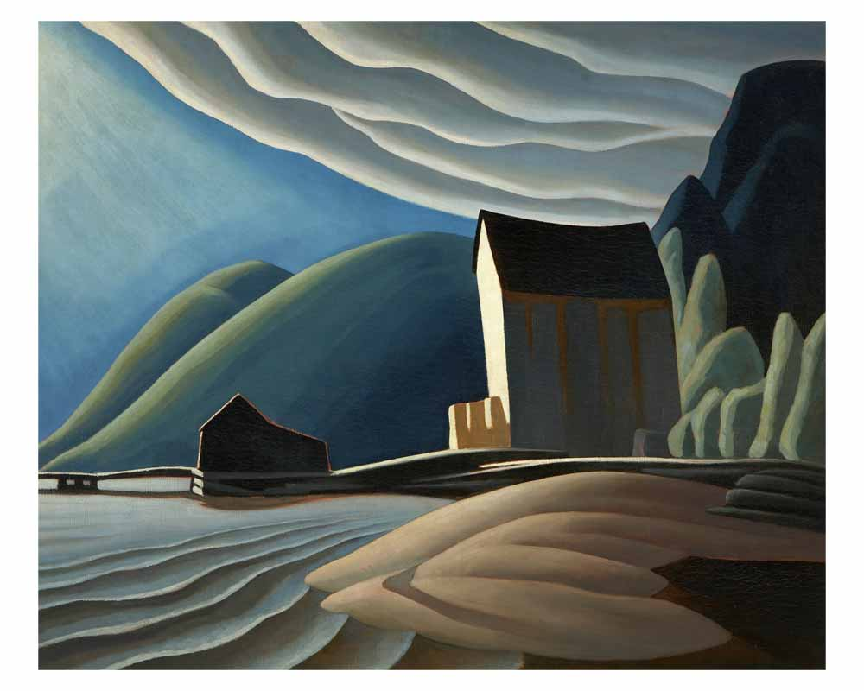
Notes:
Ice House, Coldwell, Lake Superior, 1923

Slide 6
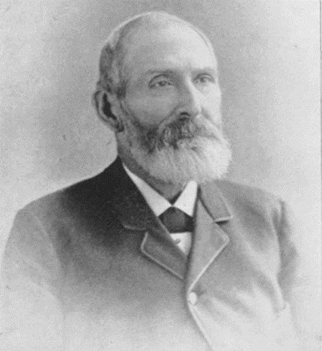
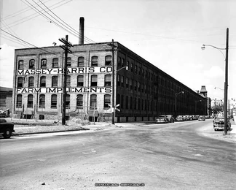
Lawren's Grandfather
Massey-Harris
Alanson Harris
Notes:
Lawren Harris' grandfather is Alanson Harris of Massey-Harris and Ferguson-Harris, the farm equipment manufacturer of Brantford. Thanks to the wealth attained by Alanson and his son, Lawren's father, Lawren had the financial means to go to art school and follow his passion for painting

Slide 7
Why does this matter?
It was due to this inherited wealth that Lawren Harris could fund the start-up of the Group of Seven
This shows the wealth that came from manufacturing in Brantford in the 1800's
Lawren's artwork is influenced by his culture
can you see evidence of this in his paintings?

Slide 8
Your Assignment
Step 1:
Pick one artwork for personal analysis
Do you like it? How does it make you feel?
What artistic elements are used in this piece, and why?
think: colour to depict emotion, depth for emphasis, etc.

Slide 9
Your Assignment
Step 2:
Pick at least 2 other painting to analyse Lawren
how does this work reflect the society that Lawren grew up in?

