Slide 1
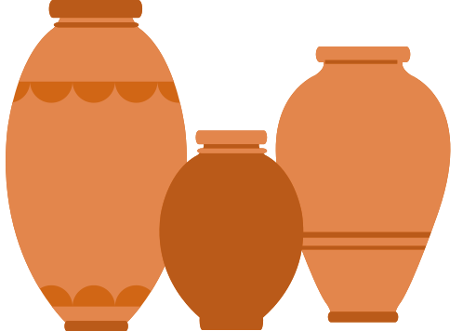
Brantford's Industry and
Pottery
Presented By The Canadian Industrial Heritage Centre

Slide 2
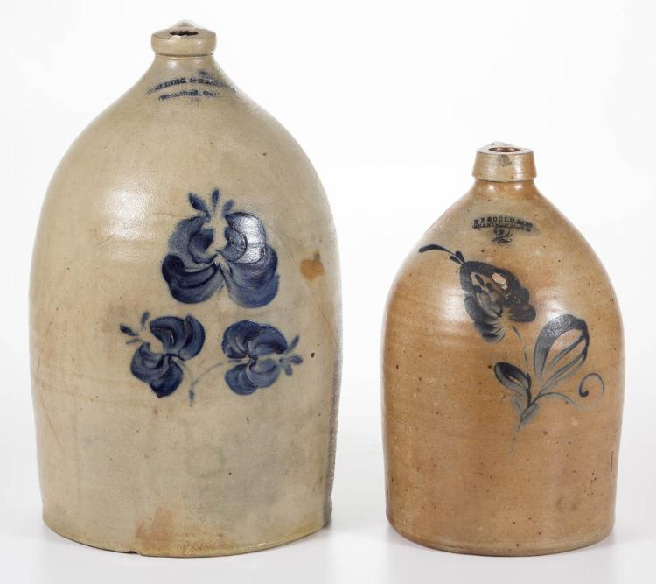
Brantford Pottery
in 1850 Mr. Morton opened up the first stoneware factory in Canada, here in Brantford
Brantford was one of the largest and most popular pottery manufacturers in Canada because it used machines instead of people
https://www.invaluable.com/auction-lot/stamped-brantford-pottery-ontario-canada-decorate-117-c-01d4b008aa
All of the stoneware used cobalt blue paint

Slide 3
Why Make Salt-Glazed Pottery?
For safe food storage
The salt creates a barrier between the food stored in the pots and the clay
The salt vaporized in the heat of the kiln and combines with the clay to create a glaze

Slide 4
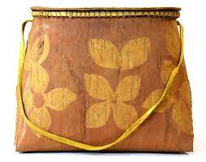
What about other cultures?
Rather than making the salt-glazed pottery like the factory in Brantford, the Anishinaabe made Birchbark containers
http://projects.leadr.msu.edu/indigenouswomen/exhibits/show/four-views-of-a-birchbark-cont/wiigwaasi-makak

Slide 5
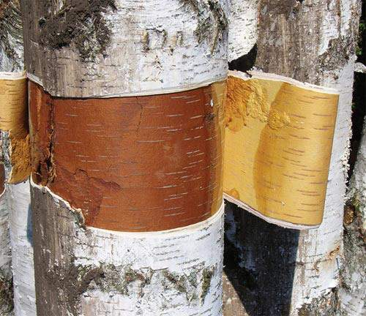
Birch Bark Boxes
These containers were made from the bark of birch trees
https://northernwoodlands.org/articles/article/getting-to-know-bark

Slide 6
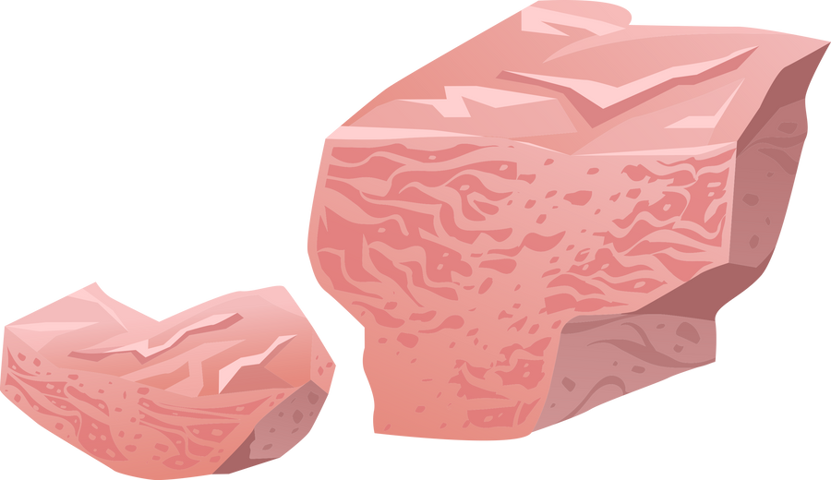
Discuss:
What are some similarities and differences between Morton's pottery and the Anishinaabe Birch bark containers?

Slide 7
Discuss:
How did the science behind salt-glaze help improve the lives of people in the 19th century?

Slide 8
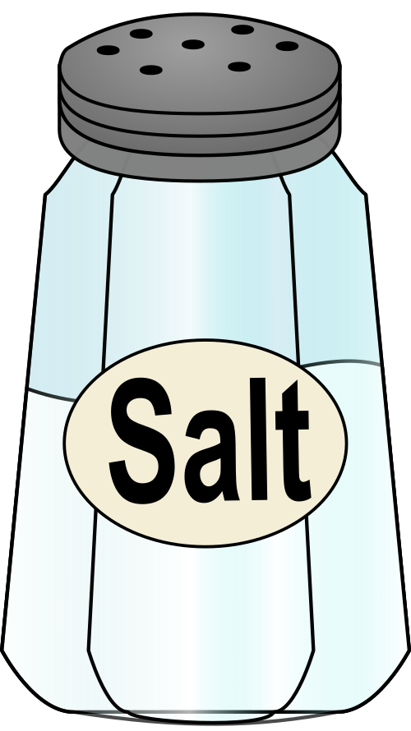
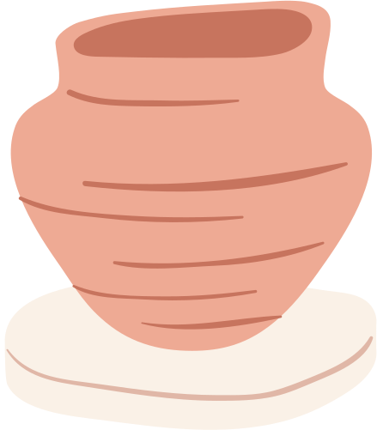
Activity
Create
Add
Paint
Your pot
your salt
Your blue design

