Slide 1
Community, History, and Soap
in Brantford
BY THE CANADIAN INDUSTRIAL HERITAGE CENTRE

Slide 2
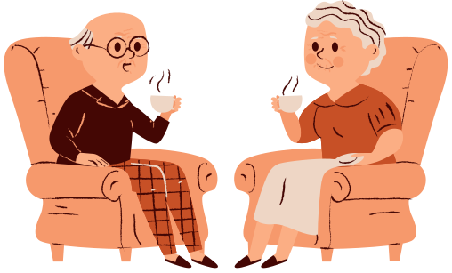
What did the community look like 100 years ago?
Notes:
Brainstorm: how would people get around, how would they buy the things they needed, what kind of jobs did they have?

Slide 3
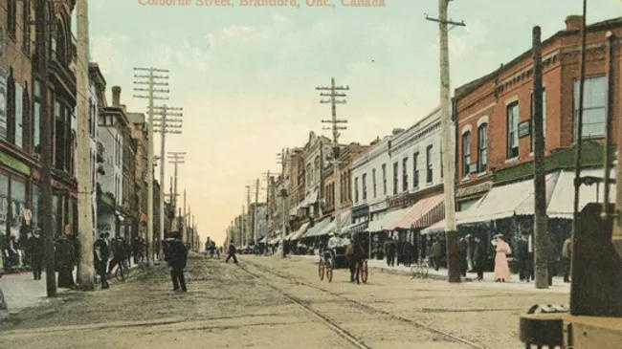
Notes:
This is a postcard of Colborne Street from the early 1900's
Let's be historians!
What do you see? What can we learn about this time just from this artifact? How did people get around? What did they wear? What did the buildings look like?

Slide 4
How did this community meet their needs?

Slide 5
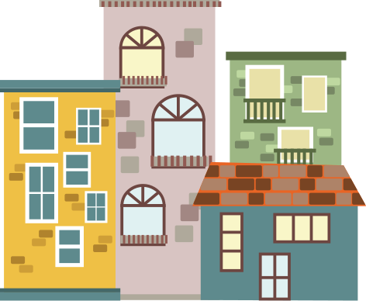
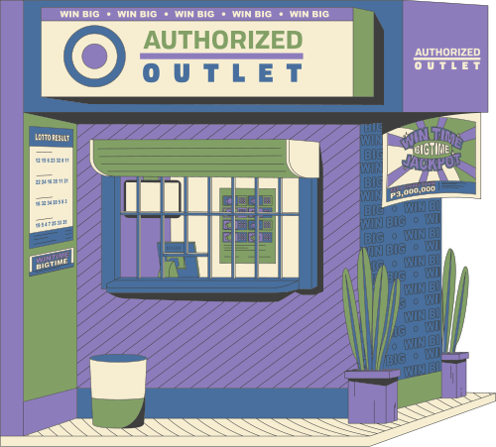
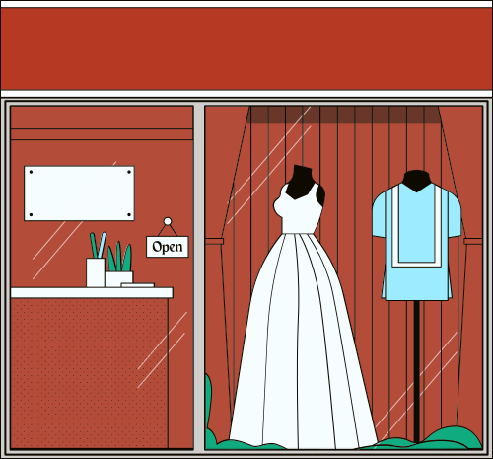
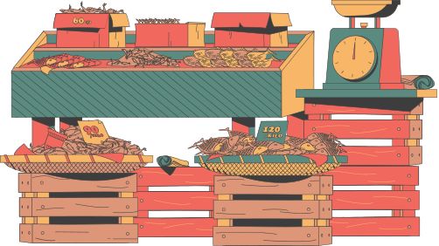
shops
grocers
tailors
Notes:
In modern times, to meet our needs of clothing, food, and other things we might order online or go into a big store. 100 years ago you bought your clothes directly from the person who made them, or some items directly from a local grocer.

Slide 6
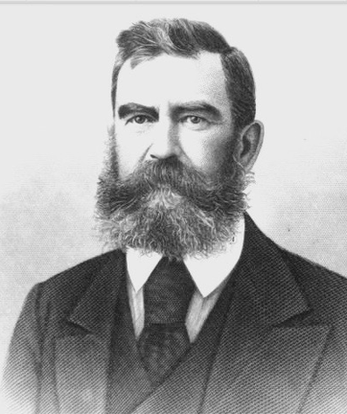
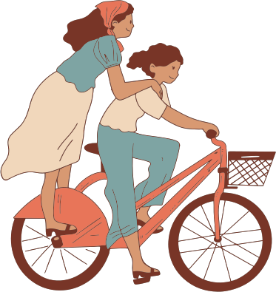
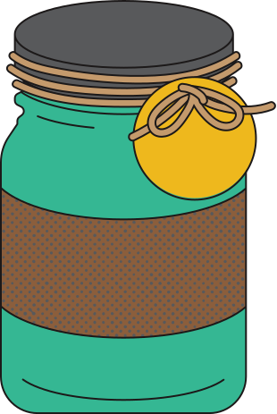
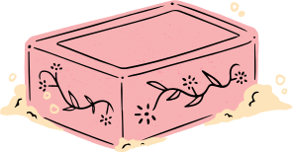
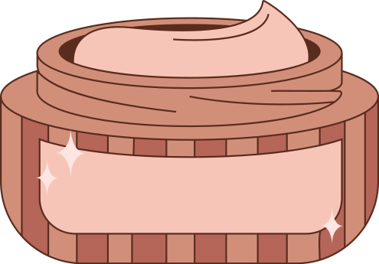
Brantford Soap Works
Owned by A. Watts
Notes:
One example of a grocer is the store owned by A. Watts. He started with a small grocery store in Brantford where he also sold soap and candles, and eventually he got so popular he made a factory just to make soap!

Slide 7
Why was (and is) soap so important?
Notes:
Let's learn some more things about soap
if the video doesn't play: https://www.youtube.com/watch?v=xAAjfdiLVLs

Slide 8
Activity
1
Complete the recipe using math
2
Follow the recipe for Squishy Soap
Notes:
Now we can pretend that we're A. Watts and we can make our own soap!

