Slide 1

The Industrial Revolution
…through snacks
By: The Canadian Industrial Heritage Centre

Slide 2
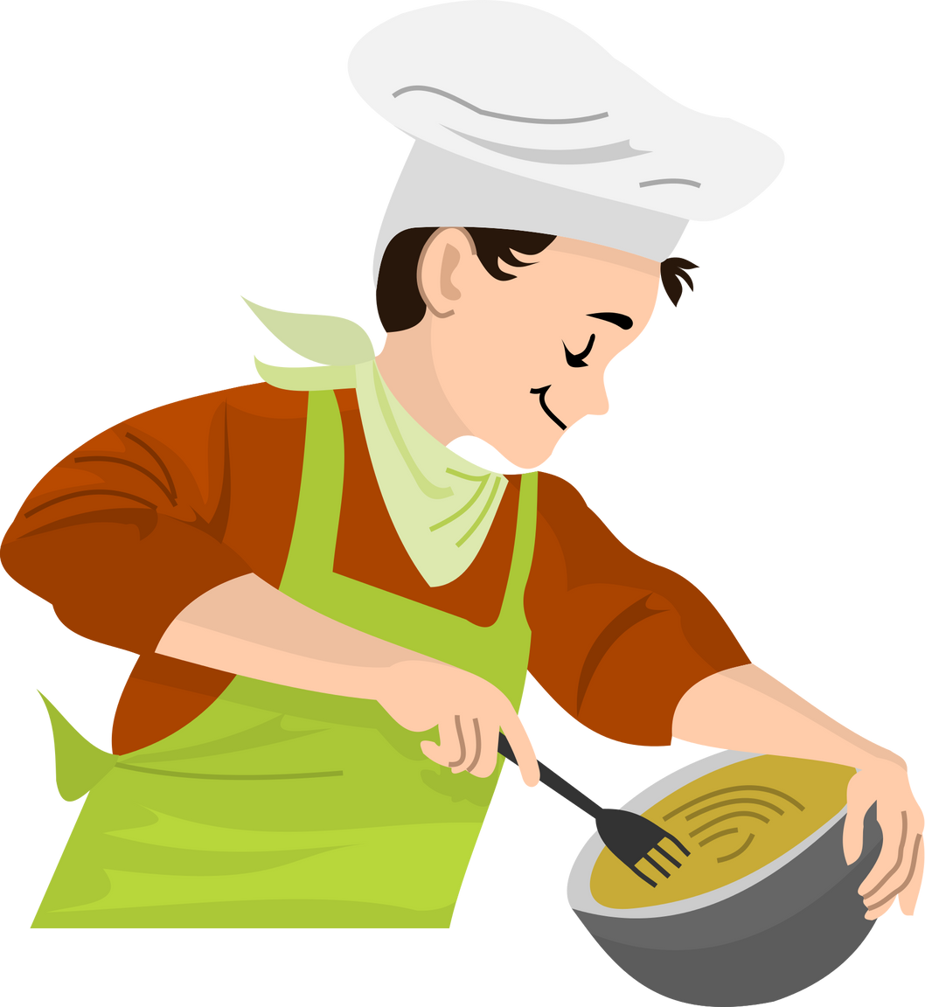

How do you follow a recipe at home?
Notes:
One ingredient at a time, using a cookbook, with your mom, etc.

Slide 3
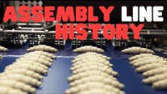
How does a factory follow a recipe?
Play video until 6:33
Notes:
If video doesn’t automatically play: https://www.youtube.com/watch?v=bxM6irrUsh8

Slide 4
Let's make an educated guess....
What would be faster, making something with or without an assembly line?

Slide 5
Now let's experiment!

Slide 6
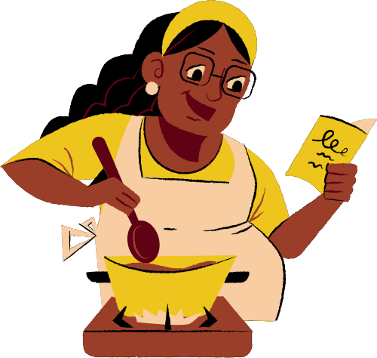
But first...
we need a recipe

Slide 7
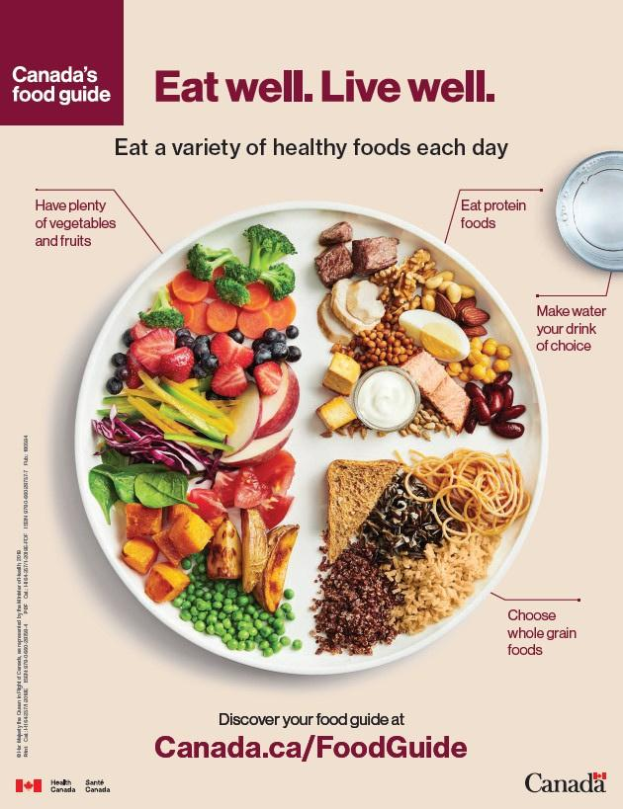

Healthy Foods
  Healthy food gives you energy
What healthy foods do you see in this image?

Slide 8

Energy Bites
Notes:
If video doesn’t automatically play: https://www.youtube.com/watch?v=VKJOlub5Pxs

Slide 9
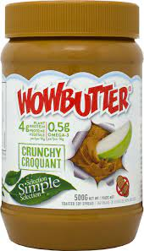
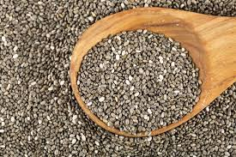
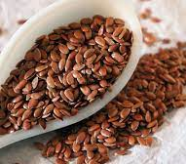
Protein
  Wowbutter
    like peanut butter, but without the peanuts!
  Ground Flax Seeds
  Chia Seeds

Slide 10
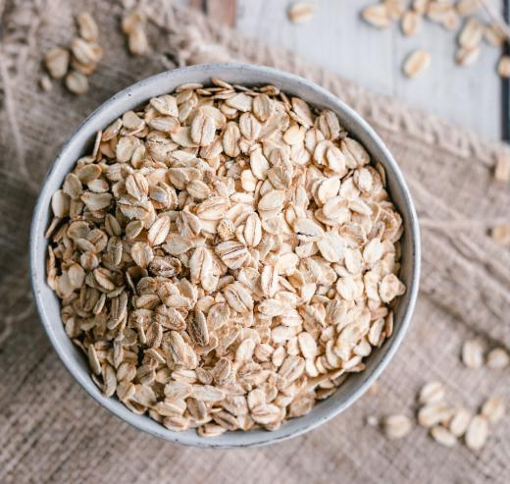
Whole Grain
  Oats

Slide 11
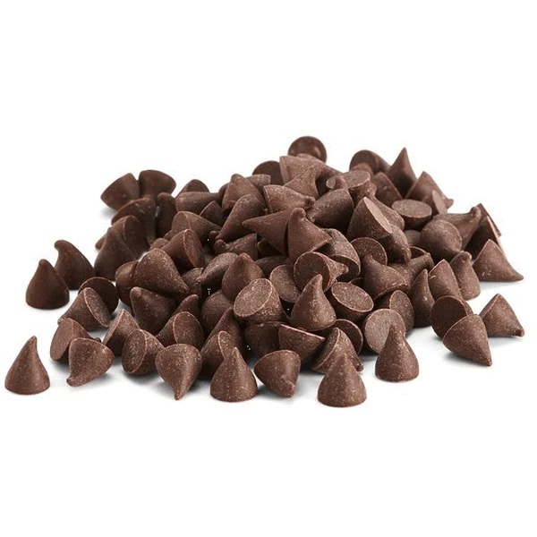

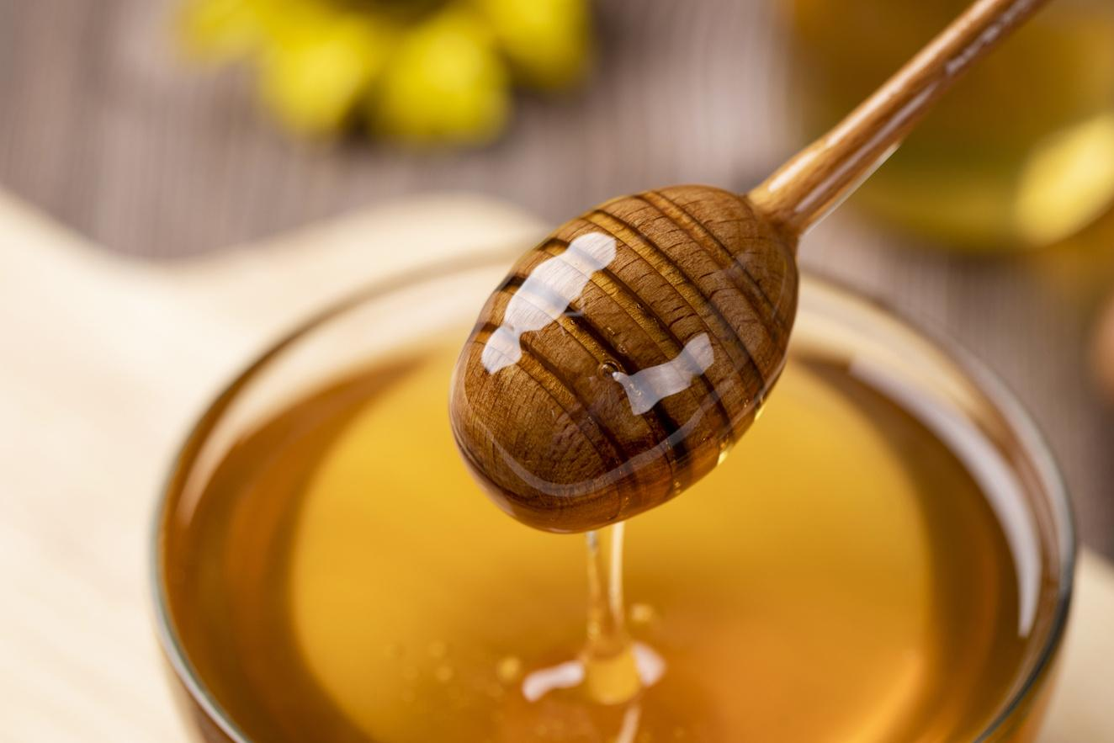
Something Sweet
(in moderation)
  Chocolate chips
  Honey

Slide 12
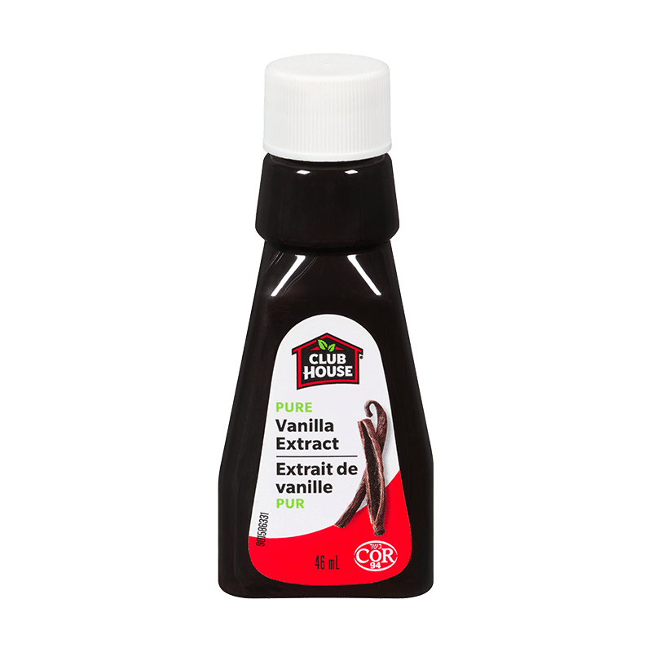

Flavour
Vanilla Extract

Slide 13
Step 1:
Fill out your Scientific Method Sheets
Step 2:
Experiment!

