Slide 1
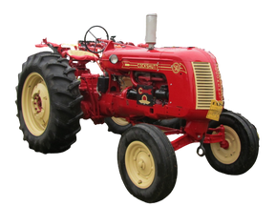
FARMING THE
PRAIRIES
By the Canadian Industrial Heritage Centre

Slide 2
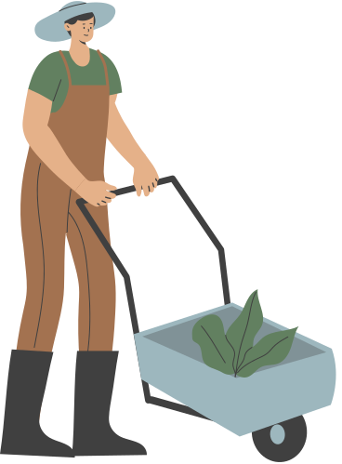
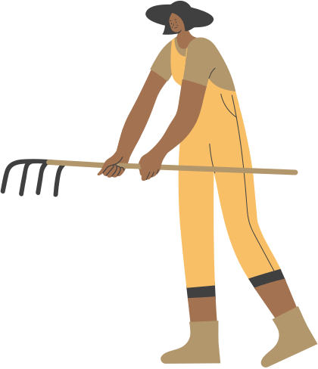
OLD MACDONALD HAD A PLOW
...and on Eastern Canadian farms, it worked great!
Cockshutt Plow Company in Brantford was making a lot of farm equipment for farmers in the area
Notes:
Plows made in Canada before the 1880s were designed specifically for the grasses and climate of Eastern Canada (and Ontario!). Cockshutt Plow and other farm manufacturers were located in Brantford and were helping local farmers by supplying important machinery

Slide 3
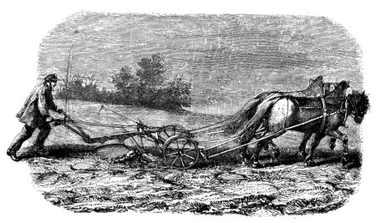
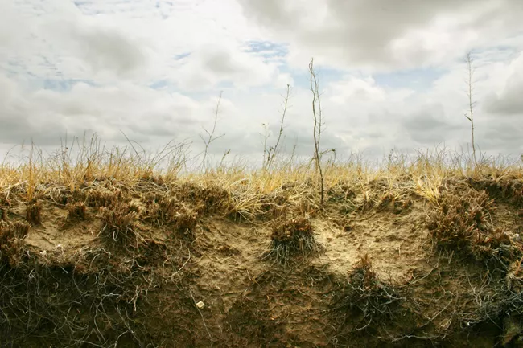
PLOW V. PRAIRIE GRASS
Who do you think would win?
Notes:
In the 1880s, settlers moved West and looked to farm and create homes in the Prairies. They brought with them the plows from Eastern Canada. Who do you think won this challenge between Eastern plows and western grass?

Slide 4
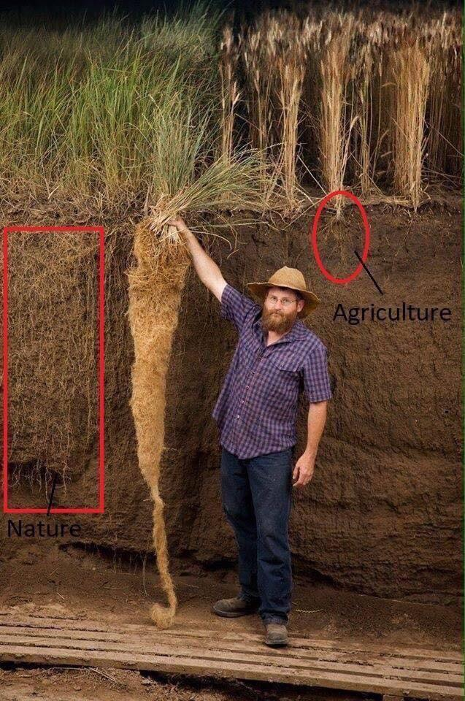
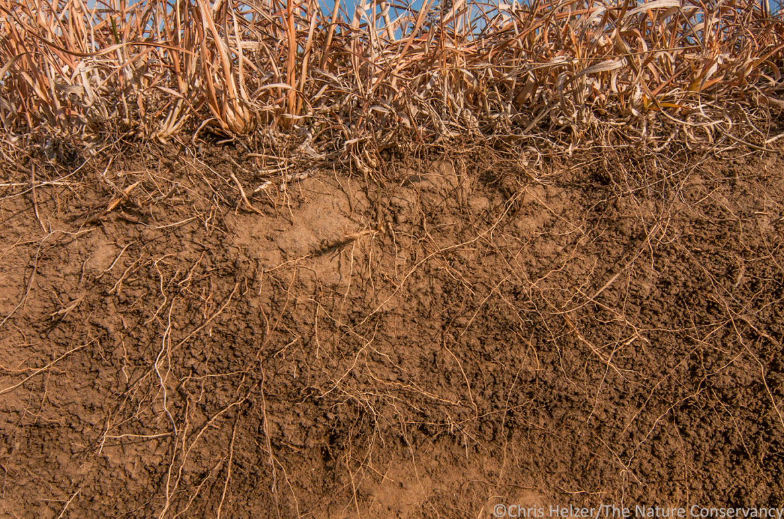
PRAIRIE SOD
...was so dense that the Eastern plows couldn't cut through it!
Notes:
The homesteaders realized quickly that their plows did not work on the tough Prairie grass and soil (called sod). Their root systems are strong and the plows could not cut through them.

Slide 5
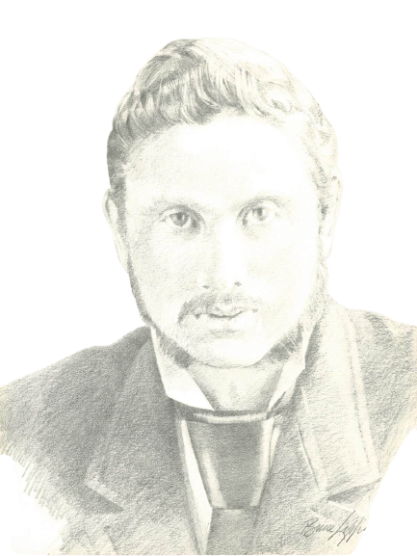
A NEW MACHINE
What if we had a plow that was strong enough to cut through strong Prairie sod??
Notes:
Luckily Brantford had James Cockshutt, who had the idea to adapt the plow so that it could till the tough sod.

Slide 6
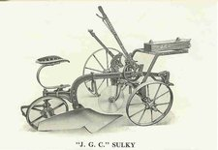
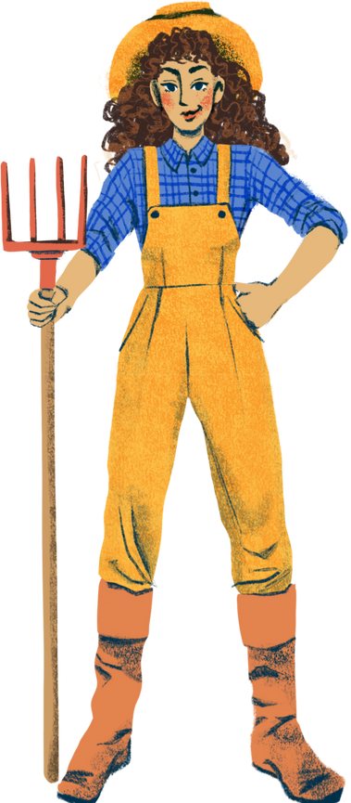
THE ONE THAT OPENED UP THE PRAIRIES
Notes:
They called it the JGC Riding Plow (named after James G. Cockshutt himself). The plow was not only sharper, but curved in a way that allowed it to cut through the roots of the sod easier. They say that this was the invention that allowed the settlers to make their homes in Western Canada

Slide 7
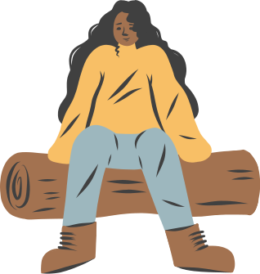
YOUR TURN
Pick a machine that works most of the time, but could be made even better!
Design, describe, craft, draw or create this new machine!
Will you be the next inventor from Brantford?

