Slide 1
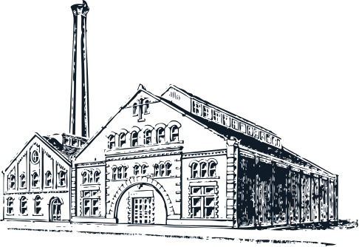
Structures
in History
Presented by the CIHC

Slide 2
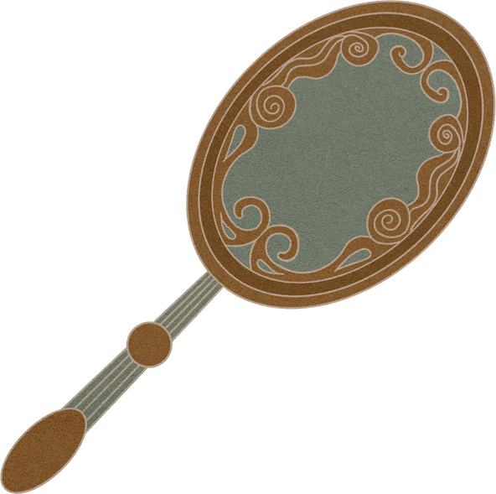
Welcome to 1900
Brantford is an industrial city
Factories are built and are continuing to grow bigger and bigger
Goods are being made
Brantford is the in the top three of producers of items for Canadians
People are happy
Factories supply jobs, community spirit, and goods for the city

Slide 3
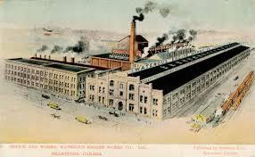
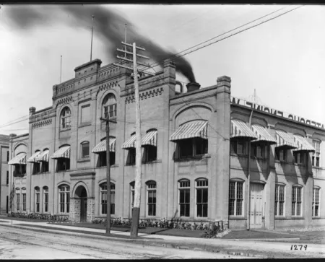
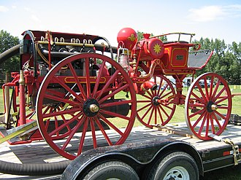
Waterous Engine Works
made steam engines and firetrucks

Slide 4
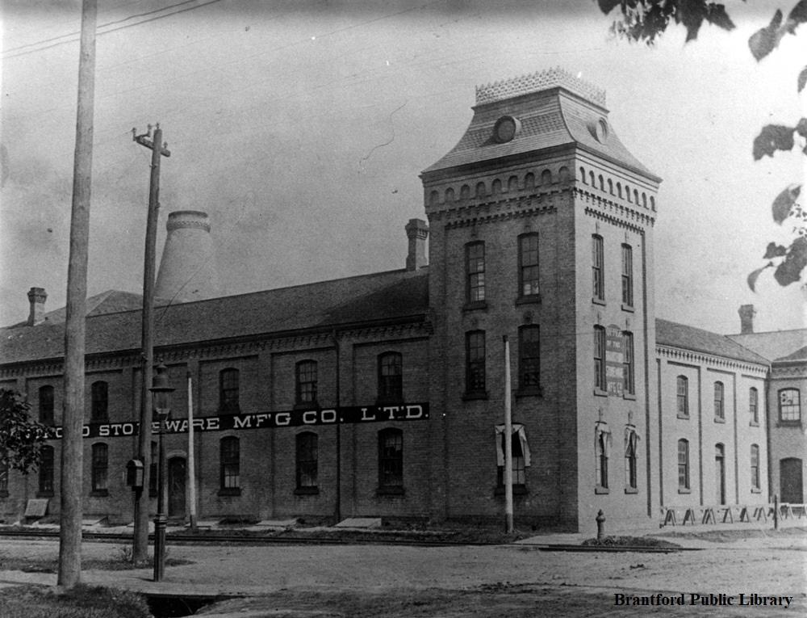
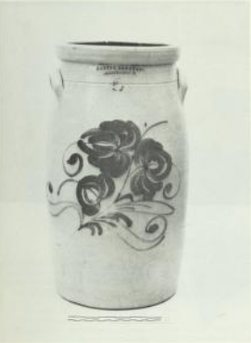
made pottery
Brantford Stoneware

Slide 5
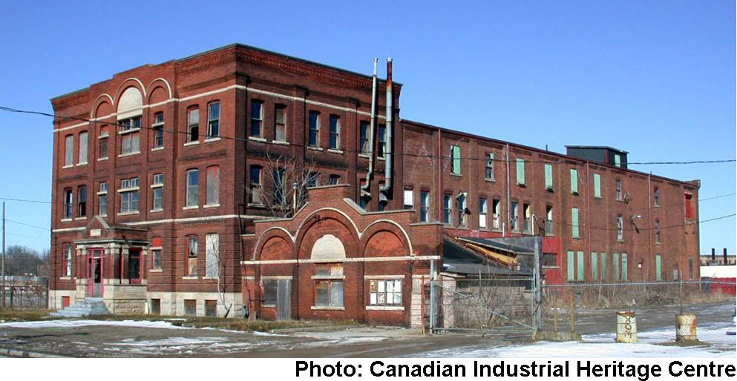
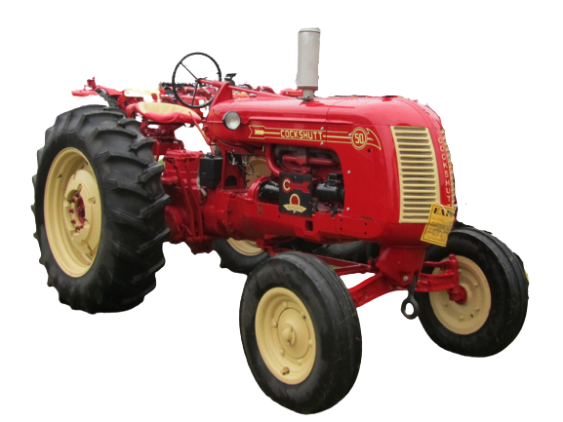
made agricultural machines
like tractors
Cockshut Plow Company

Slide 6
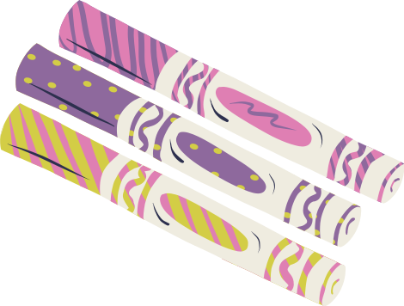
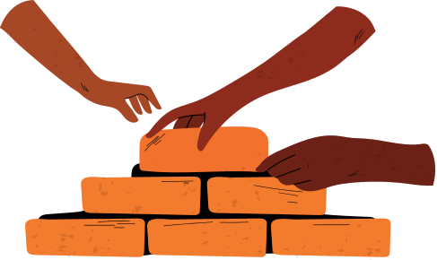
And now it's your turn!
1. Come up with an idea
If you had a factory, what would you produce?
2. Decide what materials to use
What materials make a strong and stable structure?
Will you use natural or man-made materials?
3. Build your factory
Use your artistic and scientific skills! What will your factory look like?

