Slide 1
Industry, Land Use, and the Environment

Slide 2
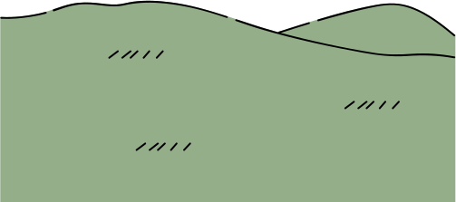
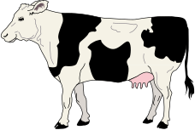
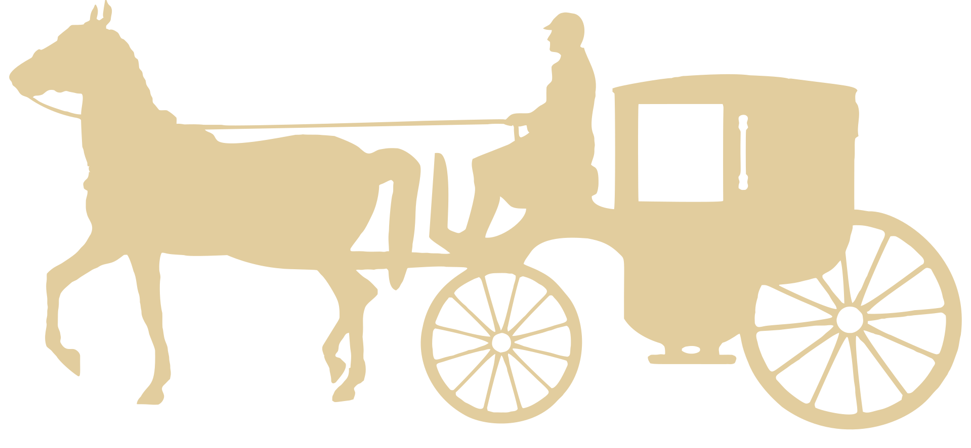
Brantford
1780-1850
Notes:
Brantford's industrial history can be traced back to the 1800's with early settlers working the land. Most of Brantford's land was used for agriculture. There were some businesses: artisans like blacksmiths and carpenters were essential for the settlement of Brantford.

Slide 3
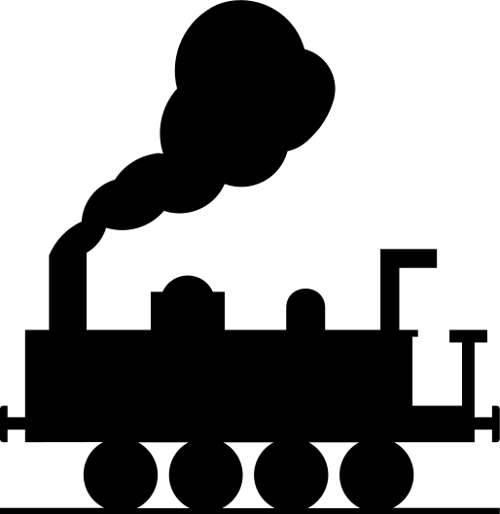
Brantford
1850-1900
Notes:
In the 1850's, a railway was made that attached Brantford to Buffalo and Goderich. This made it possible for industry to grow. The railway was used to transport materials to Brantford, the materials were used to make goods in Brantford factories, and then were sent away using the railway again.
Brantford succeeded as a industrial town, bringing success, jobs, and community together

Slide 4
Brantford
1900-2000
Notes:
By the 1900's, Brantford made the 3rd most goods in all of Canada. This came with a price though, for so many factories take their toll on the environment. In the late 1900's many factories became abandoned, leaving spoiled plots of land behind.
It was hard for the citizens of Brantford who lost their jobs at these factories

Slide 5
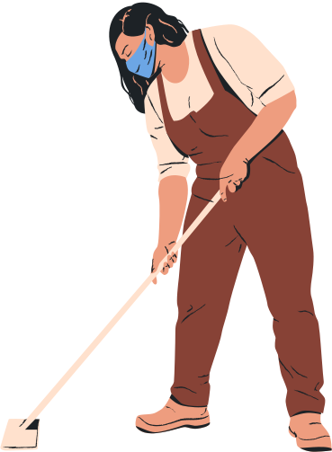
Brantford
2000-Present
Notes:
In the 2000's, the city of Brantford decided to remediate some of the old factory land and make it safe for the environment and the community again. Everyone in Brantford needs to their part in taking care of the environment.

Slide 6
Brantford
Future
Notes:
One example of this is the old Cockshut Plant on 66 Mohawk in Brantford. The Canadian Industrial Heritage Centre has saved this old building and are planning on reusing it as a museum building in the future

