Slide 1
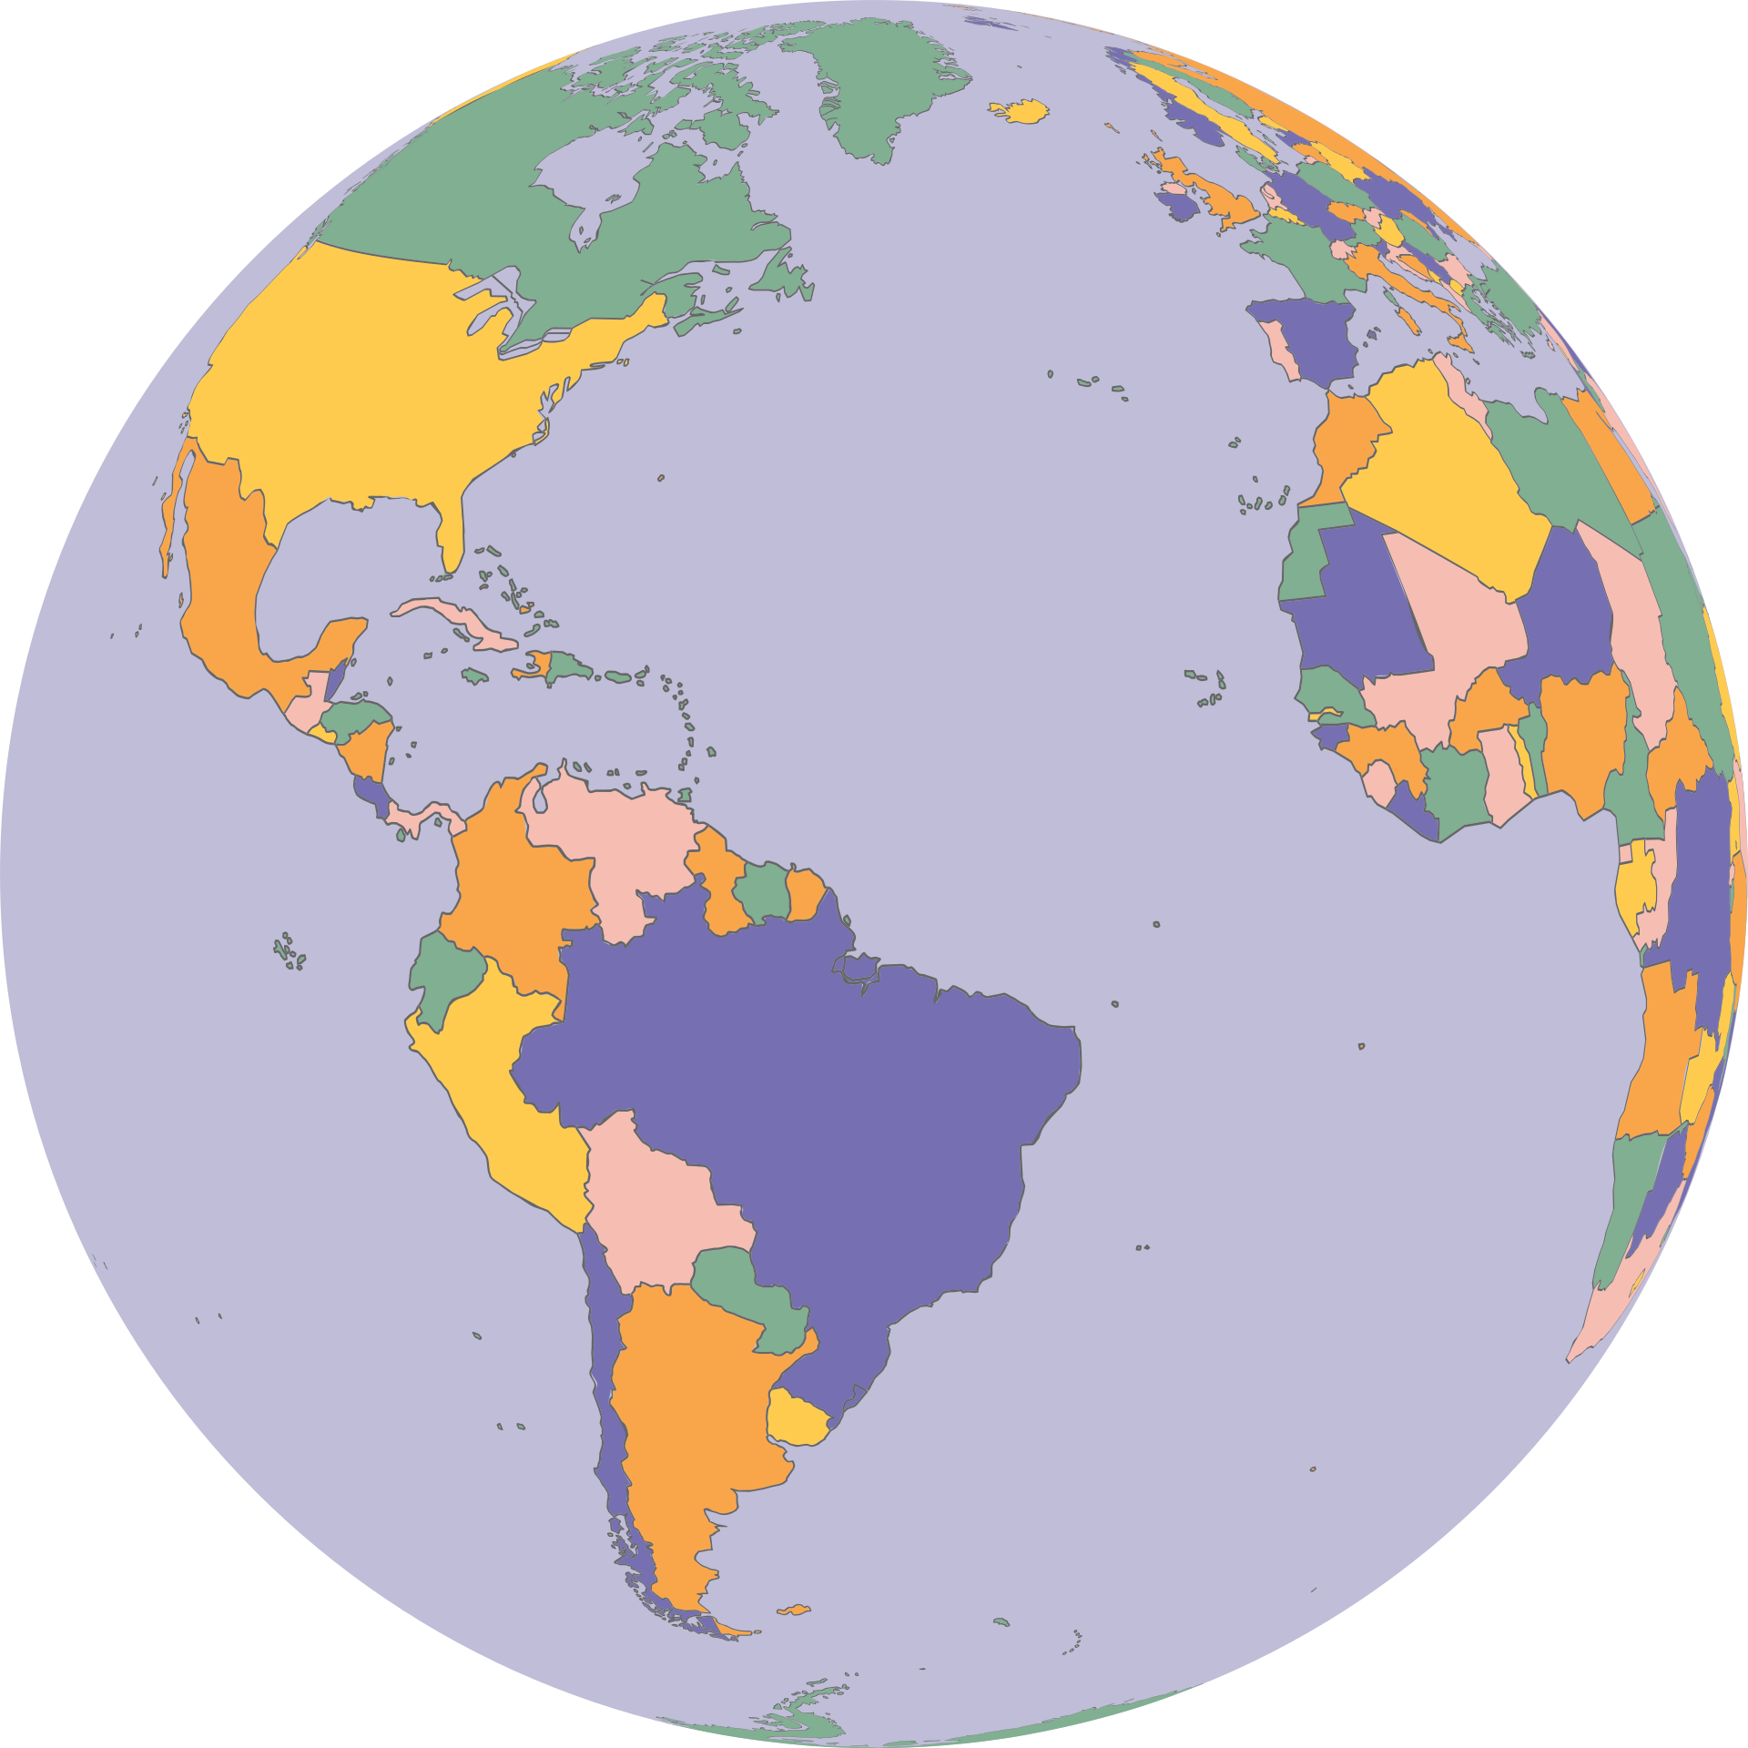
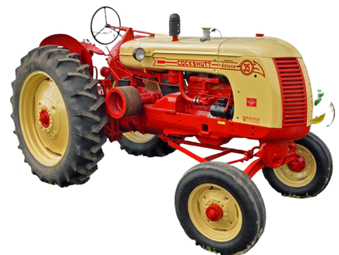
Cockshutt
Around the World

Slide 2
A Brief History of Cockshutt
1.
Where does this name come from?
2.
What did they make?
3.
Where did they go?

Slide 3
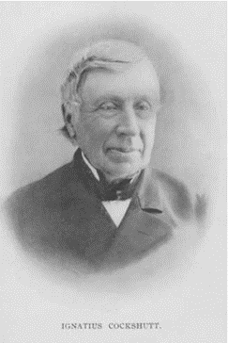
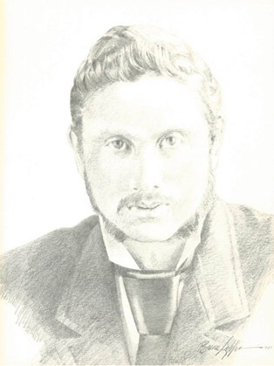
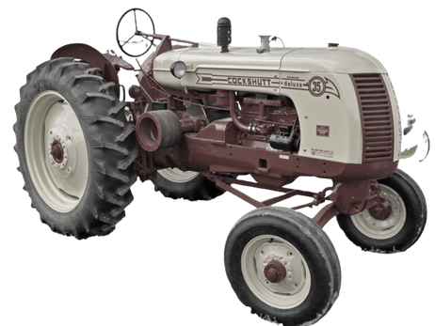
Father and Son
Ignatius Cockshutt
James G. Cockshutt
1.
Where does this name come from?
Notes:
Ignatius Cockshutt was born in Great Britain in 1812. When he was 15 he and his family moved to where is now Toronto. Ignatius's father started a business in Brantford, and when Ignatius was 28 his father sold the business to him and his sister, Jane. They then named the company I. & J. Cockshutt. At this point, James Cockshutt was 10 years old. As James aged, he put his creativity and energy into making the company even better. He made farm machinery that was completely innovative. He started up the Brantford Plow Works which he then renamed The Cockshutt Plow Company with his father, Ignatious. These tractors, plows, and other farm machines became very popular.

Slide 4
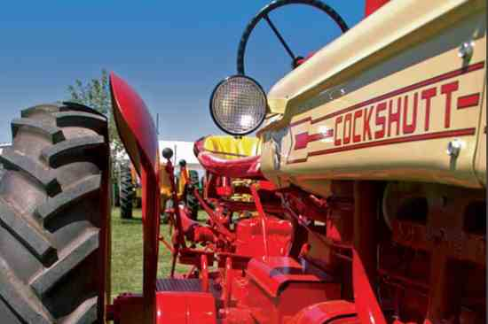
Cockshut Plow Company
Farm equipment
mainly tractors and plows
Opened up the prairies
2.
What did they make?
Notes:
The Cockshutt Plow Company, led by James, made special farm equipment. One machine, called the "three wheeled single furrow plow" allowed a farmer to sit while he plowed, rather than pushing it from behind. He also made plows that were specifically designed for the special dirt in the Canadian prairies.

Slide 5
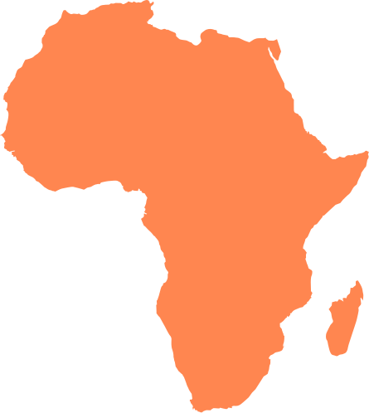
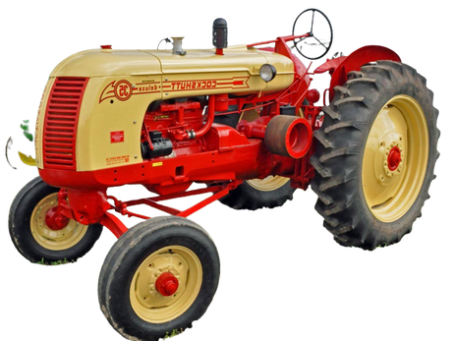
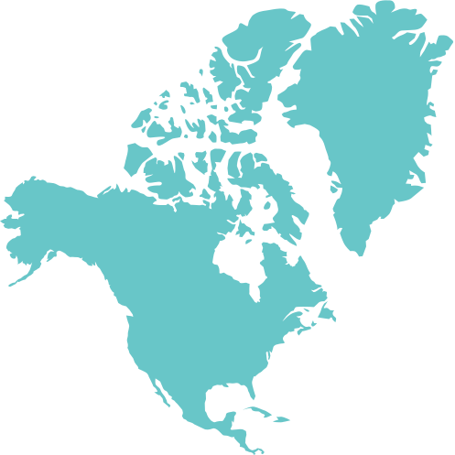
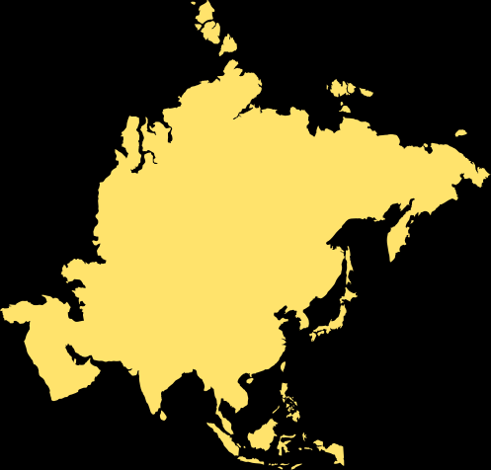
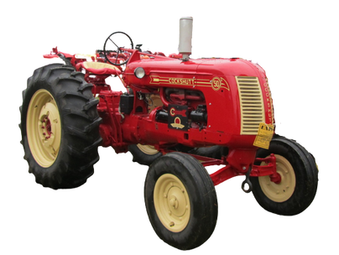
Brantford's Cockshutt Farm Equipment was exported around the world
3.
Where did they go?
Notes:
Amazingly, even in the 1940's the Cockshutt Plow Company delivered farm equipment around the world. Our activity today will help us identify which countries they exported goods to.
But first, we have to learn how to find these countries on a map.

Slide 6
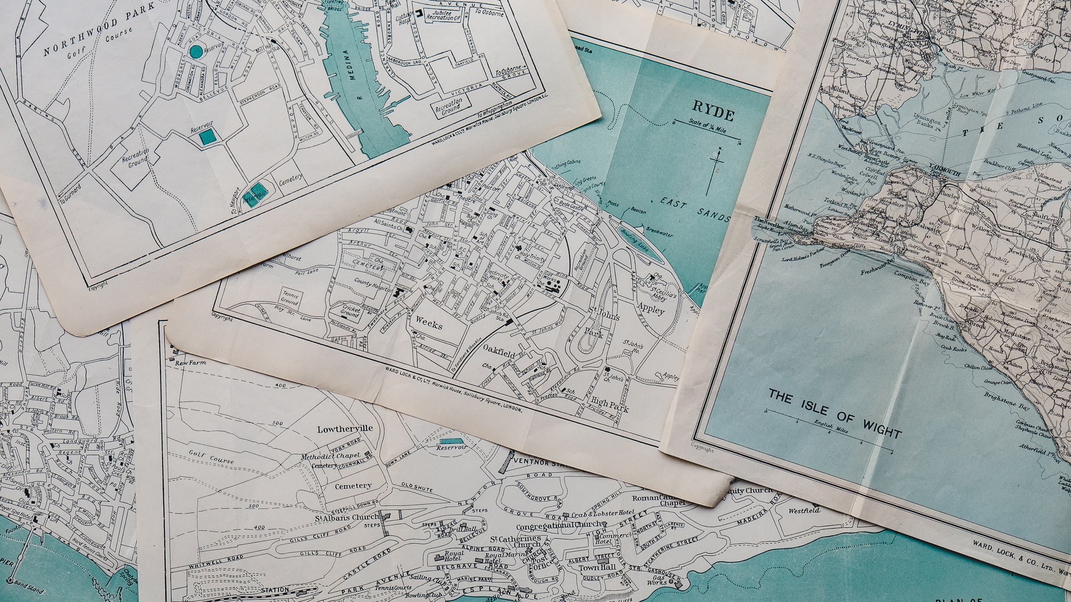
How do we identify where a country is on a map?

Slide 7
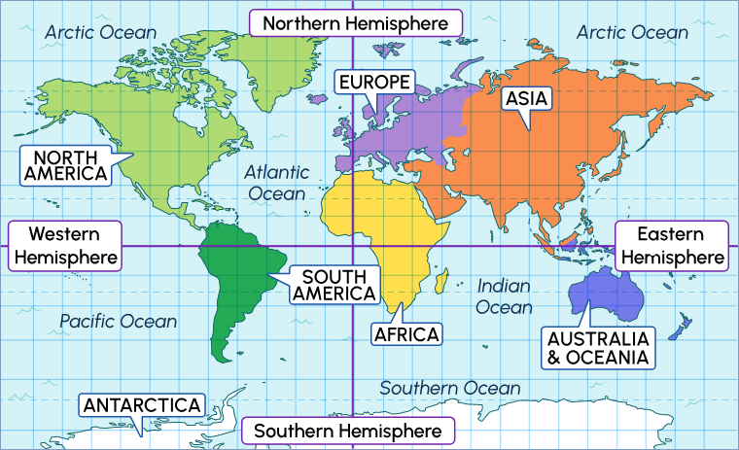
https://tvolearn.com/pages/grade-6-social-studies-people-and-environment-learning-activity-1
Notes:
The world is split in half two different ways. With the imaginary line, the equator, the world is spilt into the Northern and Southern Hemisphere. With the Prime Meridian, the world is split into the Western and Eastern Hemisphere. Let's identify where we live.
The video on the next slide will teach us a bit more about this.

Slide 8
Video https://www.youtube.com/watch?v=LzRkyFE_wCEhere

Slide 9
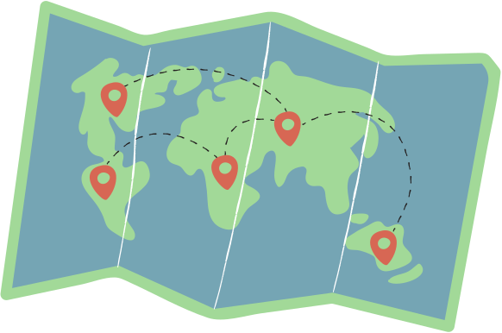
Activity time
1.
Open your map and have your worksheet ready
2.
Fill out the map, labelling each country with a different colour as you go along
3.
Answer the reflection question on the worksheet
4.
Save your map and worksheet and submit it to your teacher
Notes:
Now that we know that farm equipment was sent from Brantford, all around the world, and we know how to find countries on a map, we can practice this.

